Slide 1
HISTORY OF PROJECTIVE GEOMETRY
Presented by
Mr. CARMEL PUSHPA RAJ J
Assistant Professor
Department of Mathematics
SJC

Slide 2
Contents
Projective geometry
Subfields
Examples
History
Conclusion

Slide 3
Projective geometry
In mathematics, projective geometry is the study of geometric properties that are invariant under projective transformations.
This means that, compared to elementary geometry, projective geometry has a different setting, projective space, and a selective set of basic geometric concepts.

Slide 4
subfields
Projective algebraic geometry
The study of projective varieties
Projective differential geometry
The study of differential invariants of the projective transformations

Slide 5
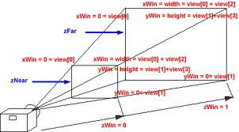
This type of projection can be modeled by projective geometry

Slide 6
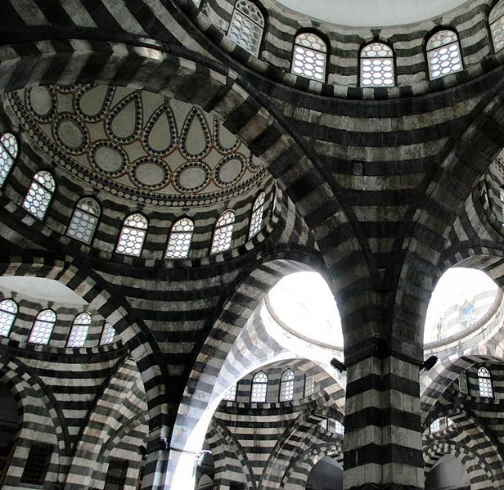
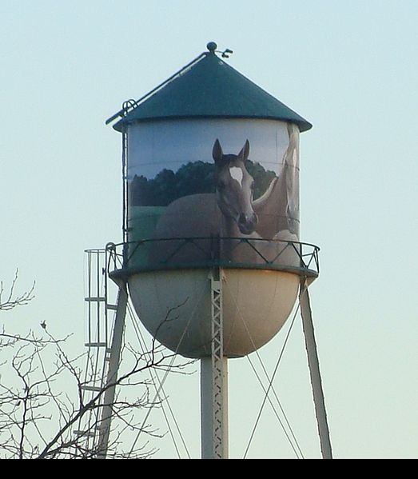


Slide 7
The simplest illustration of duality is in the projective plane
“Two distinct points determine a unique line"
(i.e. the line through them)
“Two distinct lines determine a unique point"
(i.e. their point of intersection)

Slide 8
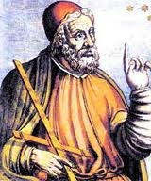
HISTORY
The first geometrical properties of a projective nature were discovered in the third century by Pappus of Alexandria. (Greek Πάππος ὁ Ἀλεξανδρεύς)

Slide 9
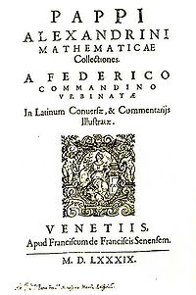
A teacher in Alexandria
Synagoge or Collection
Pappus's Theorem in projective geometry
a compendium of mathematics in eight volumes
Title page of Pappus's Mathematicae Collectiones, translated by Federico Commandino (1589).
geometry
recreational mathematics
doubling the cube
polygons
polyhedra.

Slide 10
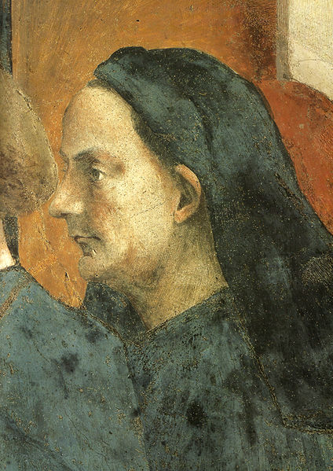
Filippo Brunelleschi (1404–1472) started investigating the geometry of perspective in 1425
The work in the fine arts which motivated much of the development of projective geometry

Slide 11


(1)Brunelleschi's dome for the Duomo of Florence, Santa Maria del Fiore
(2) Section of the dome

Slide 12
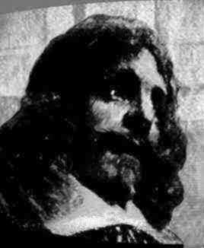
Gérard Desargues (1591–1661) developed an alternative way of constructing perspective drawings by generalizing the use of vanishing points to include the case when these are infinitely far away.

Slide 13
worked as an architect
an engineer and technical consultant -entourage of Richelieu
Desargues' theorem,
the Desargues graph
the crater Desargues on the Moon

Slide 14
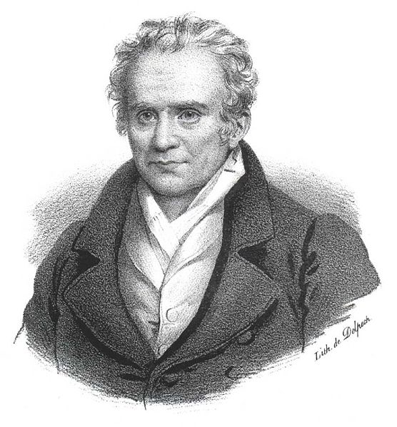
The works of Gaspard Monge at the end of 18th and beginning of 19th century were important for the subsequent development of projective geometry.

Slide 15
Jean-Victor Poncelet had published the foundational treatise on projective geometry in 1822.
Poncelet separated the projective properties of objects in individual class and establishing a relationship between metric and projective properties.

Slide 16
This early 19th century projective geometry was a stepping stone from analytic geometry to algebraic geometry.
When treated in terms of homogeneous coordinates, projective geometry looks like an extension or technical improvement of the use of coordinates to reduce geometric problems to algebra, an extension reducing the number of special cases.

Slide 17
Projective geometry formalizes one of the central principles of perspective art
In essence, a projective geometry may be thought of as an extension of Euclidean geometry.

Slide 18
Projective geometry also includes a full theory of conic sections, a subject already very well developed in Euclidean geometry.

Slide 19
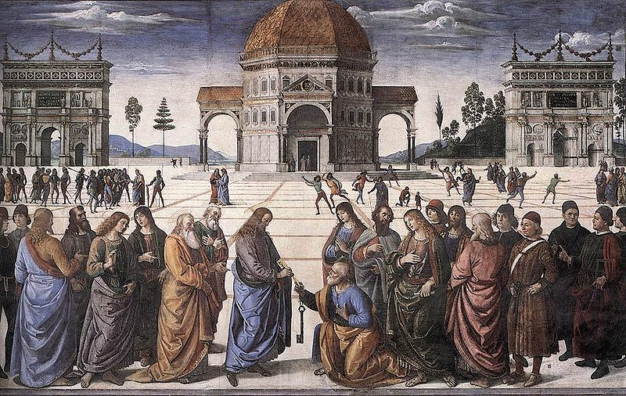

Slide 20
Thank you…

